Slide 1
Welcome to everyone
Shahidul Islam
Course name : blockchain technology
Batch Number : BC 2304

Slide 2
security
Information security is essential for safeguarding sensitive data, maintaining trust and credibility, complying with regulations, mitigating risks, ensuring business continuity, and protecting reputation and brand image.

Slide 3
CIA triad and Non Repudiation

Slide 4
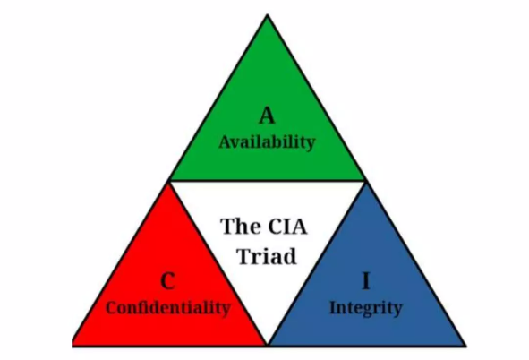
CIA Model
The CIA model, or CIA triad, serves as a foundational framework for ensuring information security. It provides a structured approach to addressing key objectives in safeguarding information assets.

Slide 5
Confidentiality
Access and privacy controls are designed to ensure confidentiality. They include the principles of identification, authentication, and authorization.
Encryption is a security control for confidentiality.
Examples of authentication controls to protect include passwords, biometrics, PINs.
Monitoring file access activity and usage provide detection measures for a confidentiality attack.

Slide 6
Few Methods to breach confidentiality (Social engineering, Password cracking, Phishing scams, Malware attacks, Unsecured networks and systems, Insider threat)

Slide 7
Integrity
Access controls ensure that information is not tampered with (modified or deleted).
Integrity can impact confidentiality and availability.
Authentication and authorization controls can ensure integrity.
An example of security control is the use of file hashes.
Attacks of integrity are the most dangerous attack. They are the hardest to detect and to deter.

Slide 8
Few Methods to breach Integrity (such as SQL injection, Malware attacks, Man-in-the-middle attacks Data tampering, Man-in-the-middle attacks)

Slide 9
Availability
Ensuring that services are available when needed to the people who need them.
Availability can be impacted by natural (fire, floods, hurricanes), environmental (power outage), or artificial (DDoS attack) events.
Security controls for confidentiality and integrity can impact availability. For example, disabling outside access to a database to protect confidentiality and integrity impacts the availability of the information in the database.

Slide 10
Few Methods to breach Availability such as DDoS attacks, Malware attacks Power outages or failures, Natural disasters, Human error or system failures Tools available to achieve availability (Firewalls, IDS/IPS, Regular backups, Cloud-based solutions)

Slide 11
Non-repudiation
Non-repudiation means that it is not possible for a user to deny performing an action that they have actually performed. This is important for ensuring accountability and preventing fraud.

Slide 12
CIA Triad Controls
Confidentiality - encryption with a secret key, hashing, steganography
Integrity - hashing (tampering/modification detection)
Availability - redundancy

Slide 13
Overall the CIA Model is widely used by organizations of all sizes to develop and implement security policies and procedures. It is also used by security professionals to assess the security risks of information systems and to design and implement security solutions.

Slide 14
THANK YOU

